Slide 1

CLIMATE WINS: PREDICTING CLIMATE CHANGE WITH MACHINE LEARNING
11/05/2025
Andreas Tocci

Slide 2

Introduction
As climate change escalates, global weather patterns are becoming more erratic. The rise in extreme weather events poses risks to the safety of numerous communities. To safeguard human health and wellbeing, ClimateWins is leveraging machine learning to accomplish the following objectives:
Detect weather patterns that deviate from the regional average in Europe
Assess whether these unusual weather patterns are on the rise
Project potential future weather conditions for the next 20 to 50 years based on existing trends
Identify the safest locations for people to reside in Europe over the next 25 to 50 years.

Slide 3
Three Thought Experiments
Classify Unusual Weather - Using hierarchical clustering, we can go beyond classifying atypical vs typical weather to find actionable categorizations.
1
Generate Accurate Predictions - Using a generative adversarial network (GAN) to synthesize weather data, we can train a convolution neural network (CNN) to predict possible future conditions over the next 50 years.
2
Identify Safe Living Regions - By optimizing a random forest model, we can identify the most important weather features to track and use that information to identify safe living regions.
3

Slide 4
Required Machine Learning Models

Slide 5
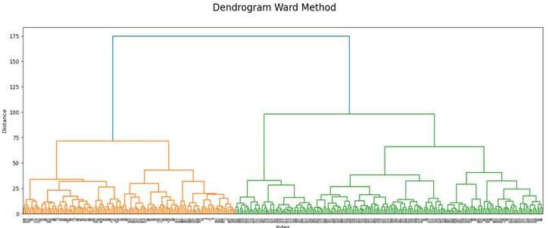
Hierarchical Clustering
Classifies each data point, combining "leaves" into branches according to their similarities. The outcome resembles an upside-down tree, with categories represented by different colours.
Benefits:
•Generates new classifications from existing data
•Does not require pre-categorization

Slide 6
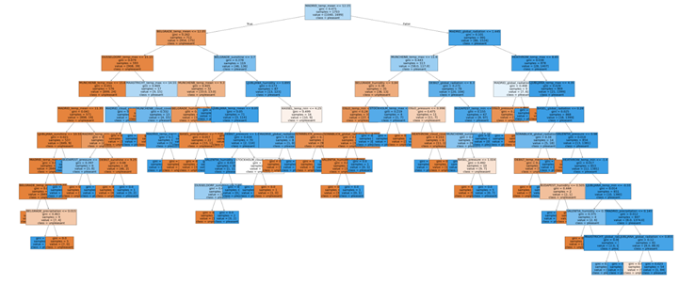
Random Forest
Organizes data through various decision tree models that classify data points using binary true/false methods. A random forest trains each tree on a random subset of the data and averages the outcomes to generate a final prediction.
Benefits:
•Averaging process reduces overfitting
•Provides clarity through visualizations

Slide 7
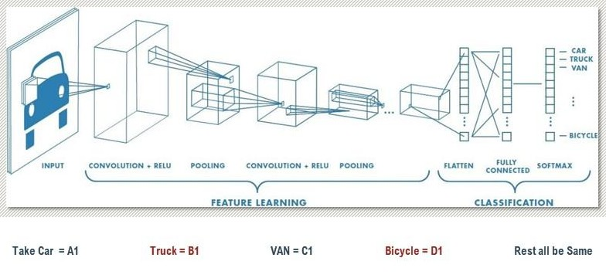
Convolution Neural Network (CNN)
By utilizing hidden layers, the CNN identifies the features of a dataset and generates classifications. Hidden pooling layers condense the data into average and maximum values, thereby decreasing the computational power needed
Benefits:
•Effectively analyzes images, including radar-generated graphics
•Capable of analyzing complex data

Slide 8
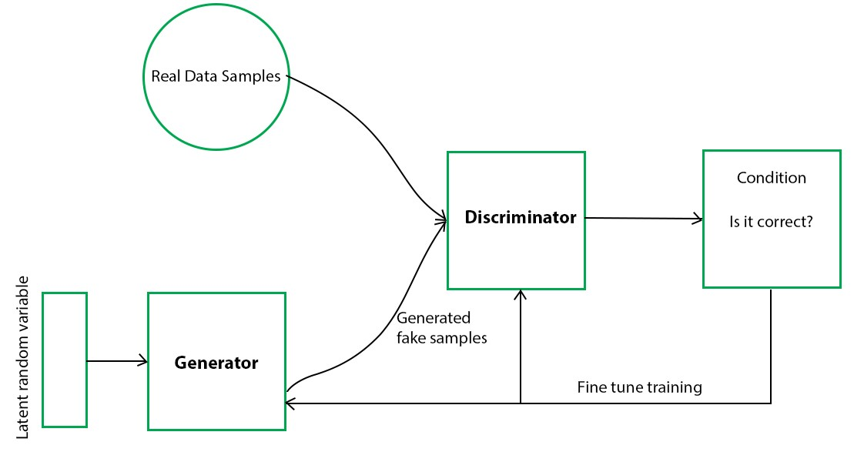
General Adversarial Network (GAN)
A generator network creates synthetic data derived from real data points. Meanwhile, a discriminator network evaluates both types of data and tries to distinguish between the authentic and the artificial. The generator then utilizes this feedback to produce more convincing "fakes.“
Benefits:
•Can create weather data that looks and behaves like observed conditions
• Increases the amount of data available for modeling

Slide 9

Necessary Additional Data
Weather Event Data - Documentation of extreme weather occurrences throughout Europe, including storms, heatwaves, and severe cold.
Radar Imagery - Weather radar data related to the areas covered by the weather stations utilized in this analysis.
Healthcare Data - Data on illnesses, injuries, and fatalities linked to extreme weather conditions.
Hazardous Weather Classifications - Definitions of what qualifies as dangerous weather, to be developed using the aforementioned datasets.

Slide 10

Experiments

Slide 11
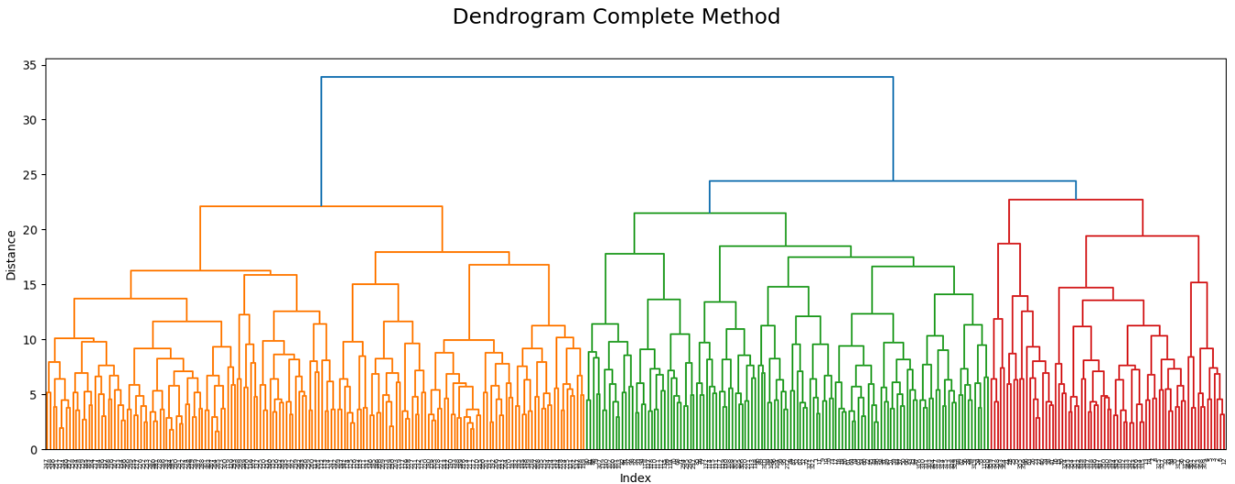
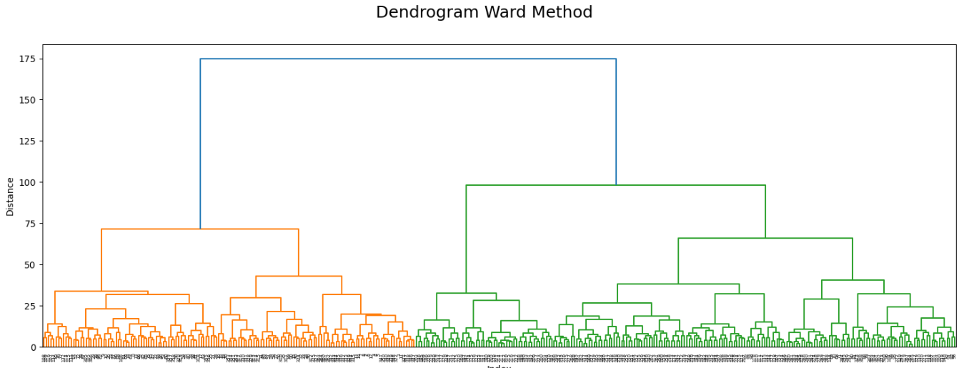
Experiment #1: Classifying Weather Using Hierarchical Clustering
Hypothesis - Using hierarchical clustering, we can go beyond classifying atypical vs typical weather to find actionable categorizations.
Objective - To identify whether unusual weather patterns are occurring.
Approach - To evaluate the feasibility of this model, we generated a dendrogram utilizing data from existing weather stations. We applied principal component analysis to minimize the number of dimensions, ensuring optimal resource utilization.
Results - The 2 main dendrograms that produced the best results where the complete method and the ward method. In the complete method we can see the data categorized into 3 main categories probably stating the severity of the weather conditions. Whilst the ward method categorizes them into 2 main categories probably standing for the pleasant and unpleasant weather conditions.
Next Steps - To enhance the value of this analysis, we suggest incorporating additional modelling approaches. Our recommendations include:
Executing this model across multiple years, seasons, and months of data to facilitate result comparisons.
Leveraging the findings to bolster other, more definitive modelling techniques.

Slide 12
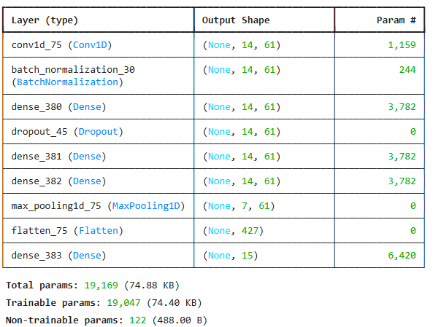
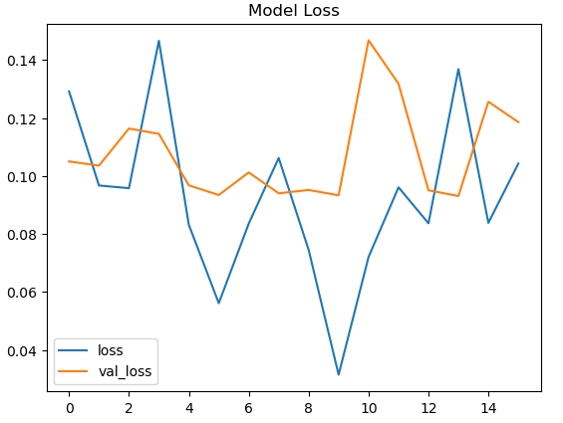
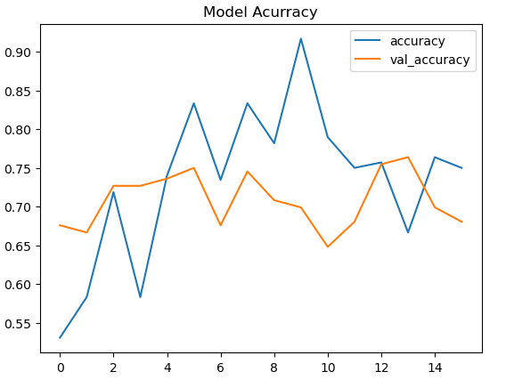
Experiment #2: Synthesizing Data to Improve Predictions
Hypothesis – Using a GAN to synthesize weather data, we can train a CNN to predict possible conditions over the next 50 years.
Objective - Generate possibilities for weather conditions over the next 25 to 50 years, based on current trends
Approach – 1. Run Bayesian optimization on a CNN model to evaluate its accuracy
2. Use a GAN to synthesize realistic weather data
Results – Bayesian optimization improved the accuracy of CNN model from an Accuracy of 12%, and Loss of 60413308.0000 to an Accuracy of 91% and a Loss of = 0.2606. Whilst the GAN produced data with an Accuracy of 75% and a Loss of 0.119.
Next Steps – Obtain the recommended radar data and perform Bayesian optimization. Run the optimized CNN model utilizing the GAN-generated data. To improve the quality of data generated by the GAN for the CNN, incorporate a larger and more diverse set of images for training. Analyze the results across different years, countries, and regions.

Slide 13
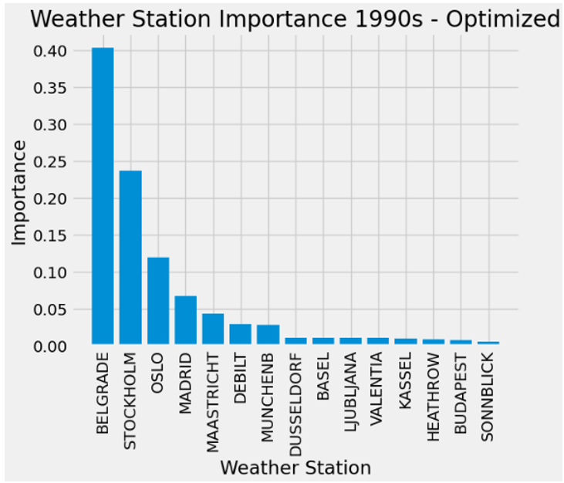
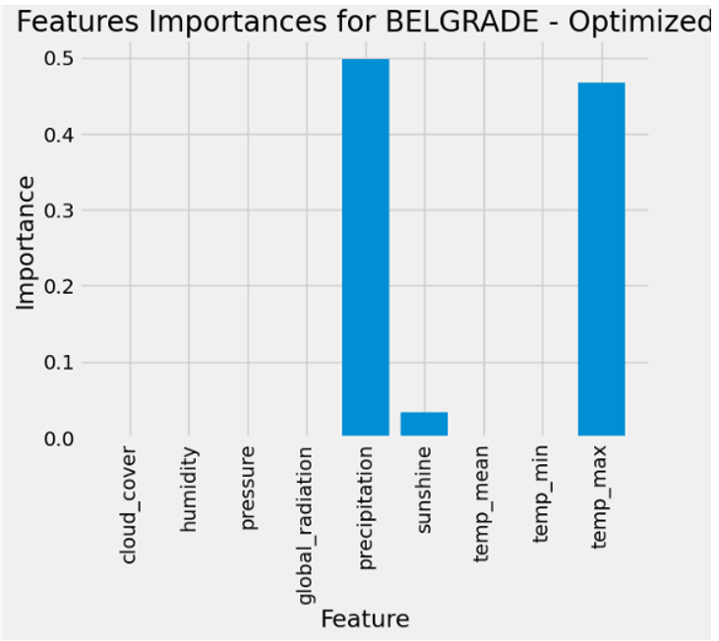
Experiment #3: Assess Regions Using a Random Forest Model
Hypothesis - By optimizing a random forest model, we can identify the most important weather features to track and use that information to identify safe living regions.
Objective - Determine the safest places for people to live in Europe over the next 25 to 50 years
Approach - 1. Refine hyperparameters for a random forest model using grid and random search methods
2. Compare unoptimized and optimized results of weather data analysis
Results – Accuracy went from 96% in the unoptimized model to 100% in the optimized model when looking at all stations in the 1990s. Running the optimized and unoptimized models allowed us to weigh feature importance in climate analysis
Next Steps - Conduct optimization processes on additional weather stations and across various decades. Apply the optimized model to extreme weather data and compare the results with healthcare data to establish correlations with human well-being

Slide 14
Recommendations
Data indicates that ClimateWins will gain the greatest benefit from allocating resources towards the optimization of GAN and CNN for weather pattern predictions:
This experiment demonstrated the most significant improvements in accuracy.
The project exhibited immediate potential for meeting essential objectives.
Data and Algorithms Needed:
CNN, GAN, and Bayesian optimization algorithms
Data on extreme weather events
Radar imagery
Classifications of hazardous weather conditions
Next steps:
Enhance the Bayesian optimization process for the CNN
Execute the CNN using data generated by the GAN
Collect and prepare supplementary data

Slide 15


